Slide 1
Oracle – Guidance notes for Supplier Portal
2018

Slide 2
INTRODUCTION
This guide has been developed to help you register as a new RFU supplier using the Oracle Supplier portal.
You should have received a New Supplier Registration pack and web link to the portal with these notes. If not, please advise your contact at the RFU and they will provide them.
Please have the following documentation ready in electronic format before you begin as you will need to attach them during this process:
Signed Supplier Code of Conduct
Completed Modern Day Slavery Checklist
Copy of bank details
As you move through the registration process your progress is tracked as per the above screen shot. The Next and Back buttons enable you to move forward and return to previous sections as you complete it.
Any questions please contact your RFU representative or main contact.
We can not support your application unless you add your RFU Representative in the ‘Notes to Approver’ Section.

Slide 3
COMPANY DETAILS
Name of supplier needs to be added to “Company” field, “Tax Organisation type” needs to be set to “Corporation” from the drop down list. The “Supplier Type” should be set as “Supplier”. The completed Supplier Code of Conduct, Modern Day Slavery Checklist and copy of bank details must be attached. This is done by clicking the + within this section.
To complete tax detail first the “Tax Country” need to be set as United Kingdom (or wherever registered), then one of either the DUNS* number, UTR number or VAT registration number needs to be added. N.B. For individuals NI number can be used in the UTR number field. We can not support your application unless you add your RFU Representative in the ‘Notes to Approver’ Section.
Contact details need to be completed to proceed.
Once done click “Next” button.
4
1
2
3
*This is a number assigned to your business if you have applied for one. The Data Universal Numbering System, abbreviated as DUNS or D-U-N-S, is a proprietary system developed and regulated by Dun & Bradstreet (D&B) that assigns a unique numeric identifier, referred to as a "DUNS number" to a single business entity. It was introduced in 1963 to support D&B's credit reporting practice. PLEASE BE AWARE YOU MAY NOT HAVE ONE - after selecting tax country please add a VAT Number or UTR number and ignore this box.

Slide 4
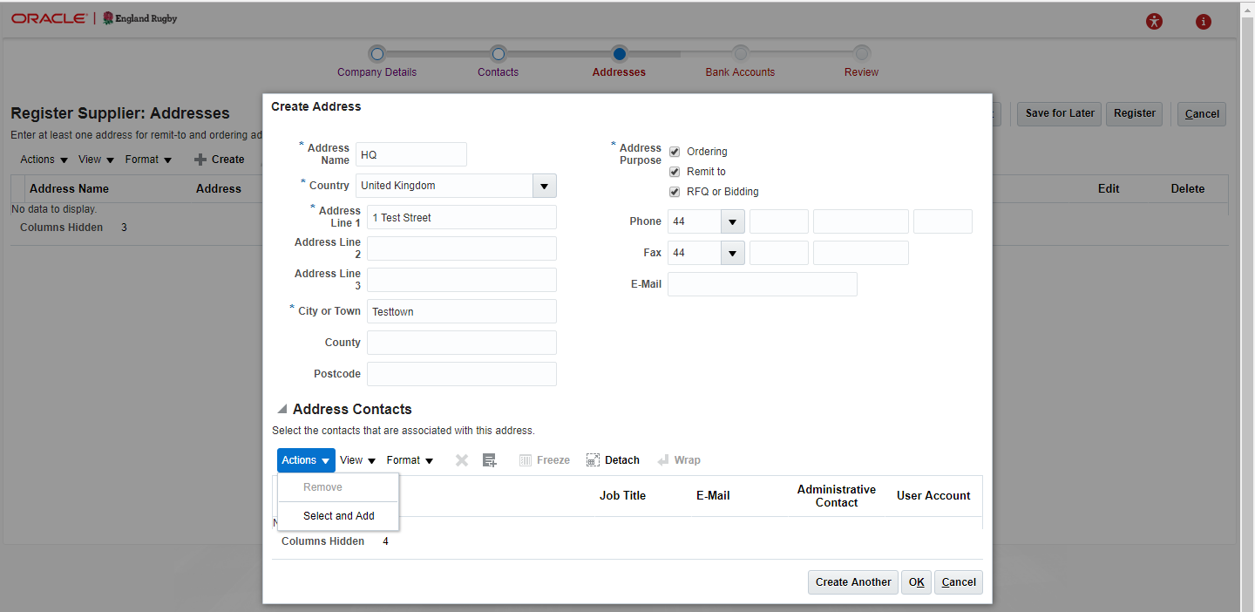
CONTACTS AND ADDRESS DETAIL
Only one contact detail is required to register. To add more than one contact i.e. sales and finance separate details, click “Create”
To move to next step click “Next”
To add the address detail click “Create” on the address page and Create Address form will open up as per screen shot
Address Name is a personal choice if you have multiple sites / offices
Please select all 3 tick boxes for Address purpose
In Address Contacts, choose Select and Add from the Actions drop down. You need to highlight one of the contacts created previously and link them to the address. Once highlighted click Apply, then click OK
Once all is done click “Next” button at top of screen to progress
2
1
4
5
3
6

Slide 5
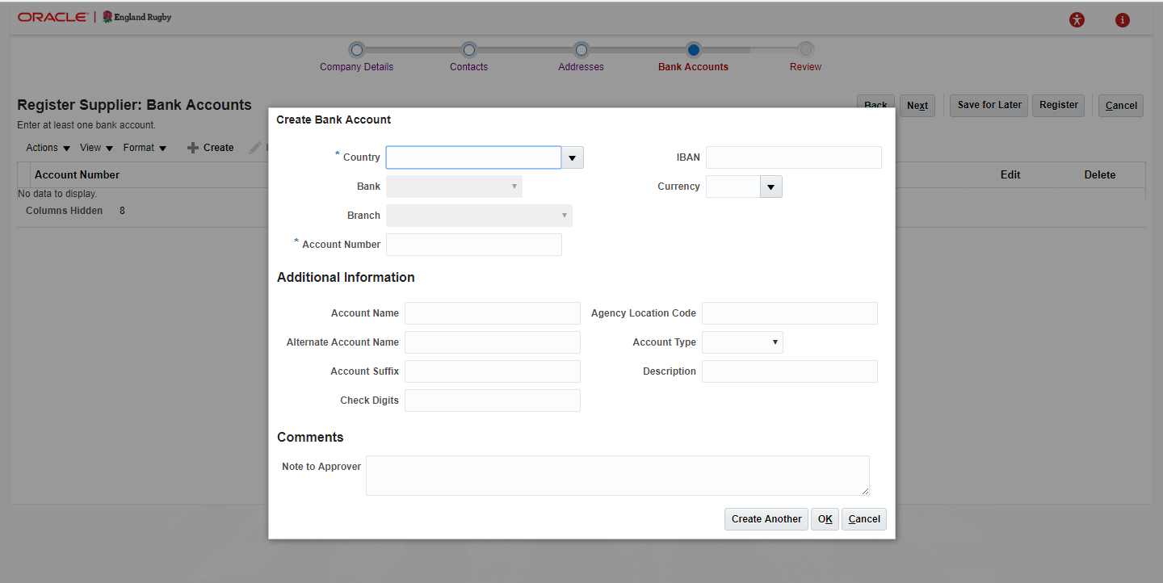
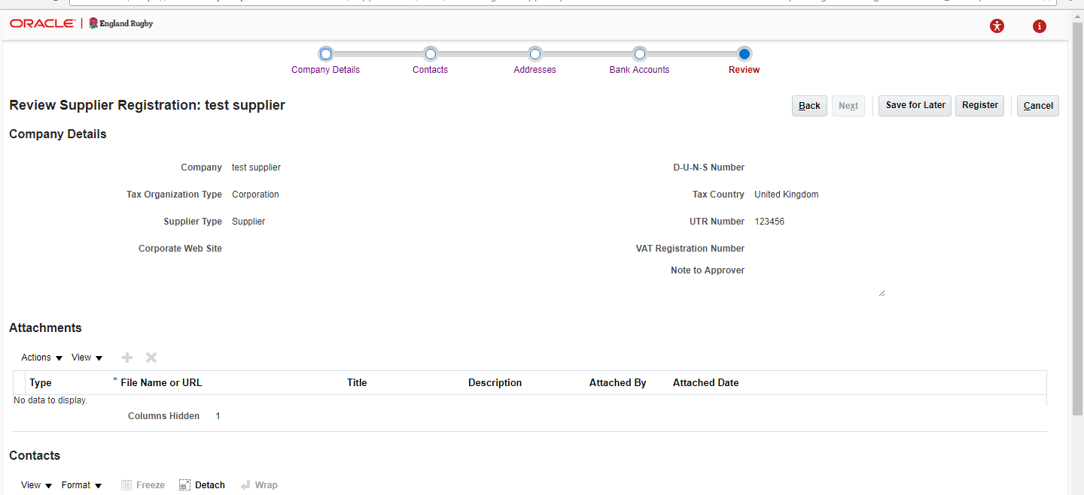
BANK ACCOUNT, REVIEW AND REGISTER
To add the Account detail click “Create” on the Bank Account page and Create Bank Account form will open up as per screen shot
Once you have completed all relevant fields, the Next button will take you to a review page where all details can be checked Please check the attachments (Code of Conduct, Modern Day Slavery Checklist and bank details) have all attached successfully
Once you are happy all is complete click “Register”
Registration is now complete. Thank you.
1
3
2

